Slide 1
BSEN 5250/6250
Lecture 5
Models of Homogeneous
Populations of Organisms
Reading: Chapter 7 of Computer Simulation in Biology by
Keen and Spain

Slide 2
Introduction
Predicting population of organisms is very important across many public and private groups in the world
An engineer’s ability to predict population dynamics and devise systems to take advantage of population dynamics is important
Current Issues
- Introduction of GMO’s into the environment
- Fermentation (cell reproduction, chemical development)
- Ecology (animal population, policy making)
- Human health (disease, food, tumor growth, etc)
- Agriculture (production, pests, physiology)

Slide 3
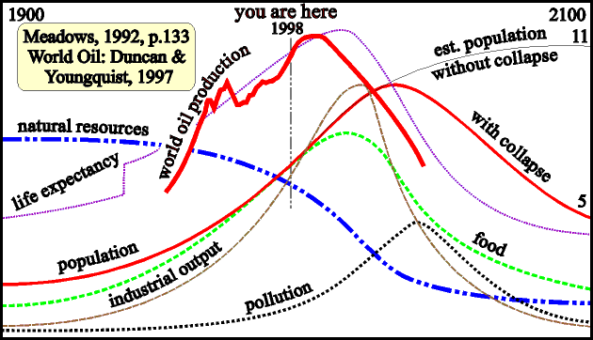
Population Biology
Populations are driven by reproduction and competitive inhibition of reproduction and survival due to limited resources (ie. nutrients, space, mates), environment or control measures.

Slide 4
Engineering Quantification of Homogeneous Populations
Homogeneous
- single type
- differences in age, sex, genotype ignored
- interaction between population is function of density
- all organisms assumed to be “average”

Slide 5
Verhulst-Pearl Equation (1838)
Where N = Population number
k = reproduction constant
t = time
N^{t+dt} = N^{t} + k*N^{t} * dt Euler Form of Solution
This equation leads to exponential behavior, which is not realistic in real populations

Slide 6
Verhulst-Pearl Equation (1838)
Assume k = a – bN
if N = 0, k approaches a, or maximum rate
if N is large, k is reduced
The original equation leads to exponential behavior, but the assumption imposed on k leads to logistic behavior

Slide 7
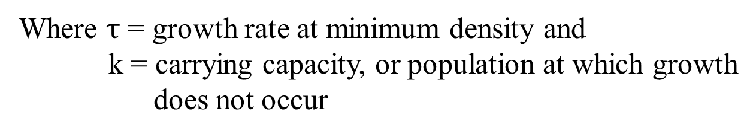
Verhulst-Pearl Equation (1838)
Substituting in k = a - bN gives
An alternative form of this equation is
(ie. Logistics Equation)
Where $τ$ = growth rate at minimum density and
k = carrying capacity, or population at which growth
does not occur

Slide 8
Verhulst-Pearl Equation- Euler Formulation
Where:
N = number
t = time
dt = time step
k = number
=1/time

Slide 9
Example 7-1: Yeast Population (Requires use of Solver in Excel)

Slide 10
Time Lags and Oscillations in Growth
Real populations typically show oscillation behavior around the carrying capacity due to delays such as the time it takes for eggs to hatch.
The Verhulst-Pearl equation can be modified to create delays that lead to oscillating behavior
N₁₀₋₃
N₁₁₋₃
N₁₂₋₃
N₁₃₋₃
N₁₄₋₃
N₁₅₋₃
N₁₆₋₃

Slide 11
Time Lags and Oscillations in Growth
Cohort – individuals with same traits such as age or weight
Examples of Cohorts:
The “Class of 2020”
Insect populations
Peanut pods
N₁
N₂
N₃
N₄₋₃
N₅₋₃
N₆₋₃
N₇₋₃
N_{t-f} = N at time t influenced by N at time t-f where f is the time lag of population expansion

Slide 12
Verhulst-Pearl Equation with Oscillation
Where:
N_{t} = number at time t
N_{t-f} = number at time t-f
f = time lag
k = number or carrying capacity
t = time
dt = time step
= growth rate, 1/time

Slide 13
Verhulst-Pearl Equation with Oscillation
Carrying Capacity
Example 7-3

Slide 14
Variable Carrying Capacity and Logistic
The carrying capacity k is often variable in nature. This especially occurs when a key input, such as food supply, temperature or weather conditions vary over time
We can modify the Verhulst-Pearl equation to simulate this effect
k
Carrying Capacity
c
Time

Slide 15
Variable Carrying Capacity and Logistic
Let K_{t} = C + k τ
Where
t = time
K_{t} = variable carrying capacity as a function of time
C = minimum carrying capacity
k = slope related to changes in carrying capacity over time
τ = time constraint on carrying capacity
τ = t for 0 ≤ t ≤ 26 weeks
τ = 52 - t for 26 ≤ t ≤ 52 weeks

Slide 16
This function creates an oscillation in carrying capacity each week during the year, then repeats itself. It represents seasonal changes in food supply
k
Carrying Capacity
c
0
26
52
26
52
Time, weeks

Slide 17
Variable Carrying Capacity and Logistic
Where:
N_{t} = number at time t C = minimum carrying capacity
k_{t} = number k = slope of change in carrying capacity
t = time τ = time constraint on carrying capacity
dt = time step τ = t for 0 ≤ t ≤ 26 weeks
g = 1/time τ = 52 - t for 26 ≤ t ≤ 52 weeks

Slide 18
Example 7-4

Slide 19
Model for Harvesting Populations
Harvesting of individuals in a population is a common occurrence. The Verhulst-Pearl equation can be modified to account for harvesting
Where C_{t} is the number of individuals harvested at time t.

Slide 20
Model for Harvesting Populations
Harvesting (C ) can be a
- single event at a given time
- a function of population
- a function over time

Slide 21
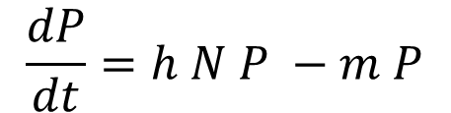
Lotka-Volterra Model of Predation (1926)
Prey Equation
Predator Equation
$$\frac{dP}{dt}=h N P −m P$$
N = population of prey, #
τ = growth rate at minimum pop, 1/time
g = efficiency of predation
P = population of predator, #
h = capture rate and conversion of prey into predators, 1/no.-time
m = predator death rate as a function of prey population, 1/time

Slide 22
Lotka-Volterra Model of Predation (1926)
Solution requires solving both equations simultaneously for each time step
Solution is very unstable with large timesteps

Slide 23
Example 7-6

Slide 24
Volterra’s Model for Two-Species Competition
N₁ and N₂ = population of species 1 and 2, number
t₁ and t₂ = growth rate of species 1 and 2, 1/time
k₁ and k₂ = carrying capacity of species 1 and 2, number
Alpha and beta = competition coefficients
Alpha converts resource use of species 2 into equivalent resource use of species 1
Beta converts resource use of species 1 into equivalent resource use of species 2

Slide 25
Example 7-10

Slide 26
Engineering Issues Related to Populations
Sensor design to measure populations
Design of control systems
Models to optimize production
Methods to control populations

